Slide 1
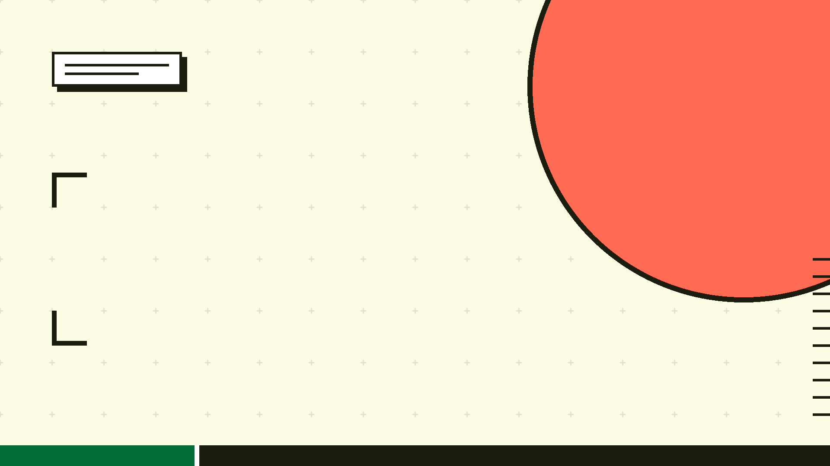
DRAKE
Dell Enterprise MCP Proxy
Infrastructure Command Center for AI-Driven Datacenter Orchestration
TEAM BITAURA

Slide 2
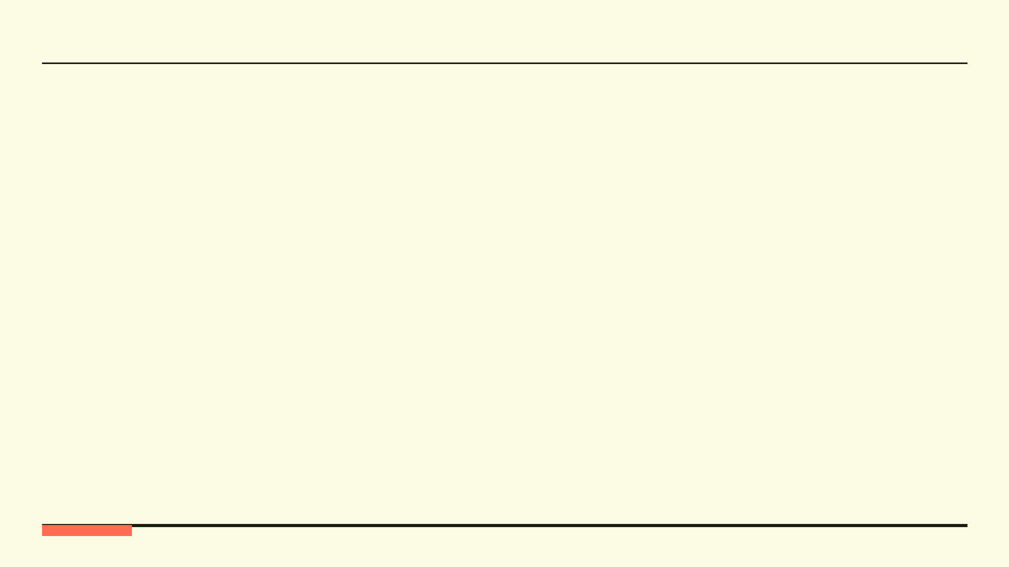
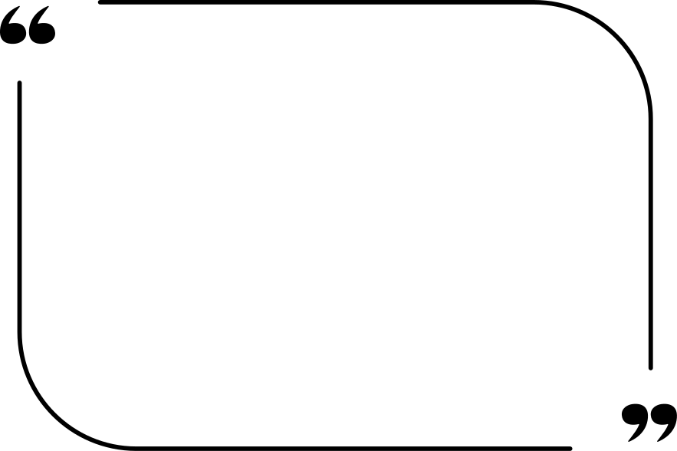
The API Crisis
Dell iDRAC exposes hundreds of low-level raw REST endpoints. A 1:1 MCP mapping consumes 120k+ tokens per request — causing LLM tool paralysis, hallucinations, and extreme latency.

Slide 3
The Chaos of Raw Enterprise APIs
The API Explosion:
Dell iDRAC exposes hundreds of low-level REST endpoints. No AI agent can reason across hundreds of low-level CRUD operations without losing context entirely.
The Context Problem:
A 1:1 MCP mapping consumes 120k+ tokens per request. Model hallucinations, extreme latency, and tool paralysis follow inevitably.
The Danger of Bare-Metal Bricking:
Partial AI workflow failures on physical servers are catastrophic. Step 1 (Mount ISO) succeeds. Step 3 fails. Result: corrupted motherboard configuration.

Slide 4
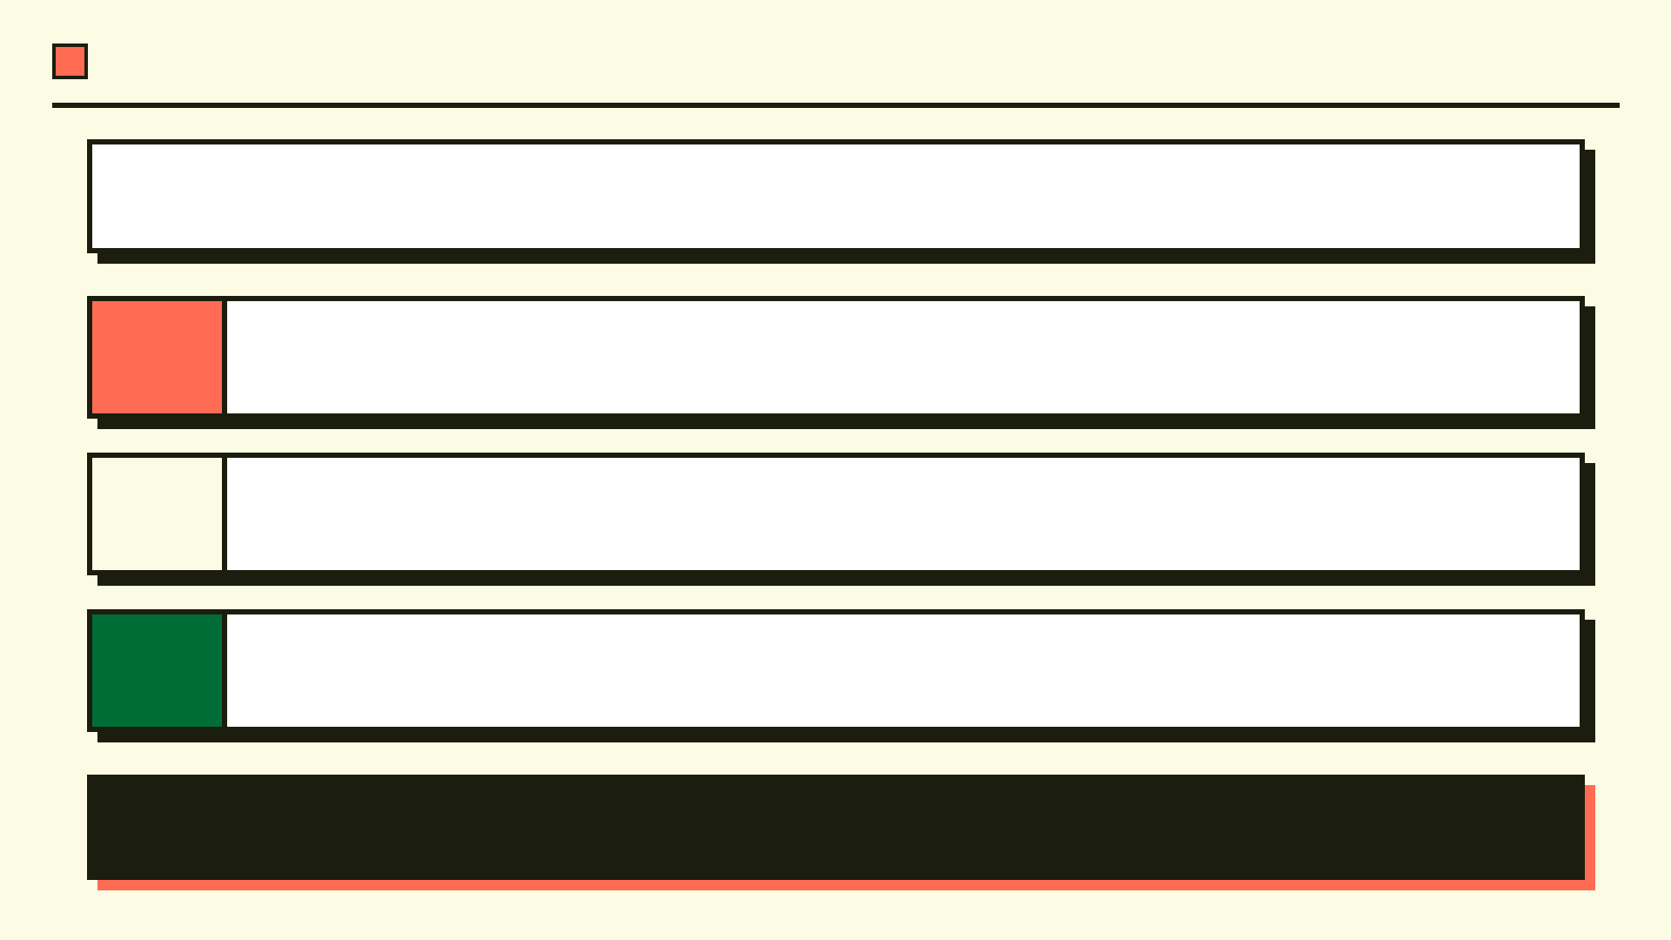
Raw API sprawl is an AI agent's worst enemy. Hundreds of low-level endpoints overwhelm context windows, cause hallucinations, and make reliable datacenter automation impossible. Drake was built to solve this.
01
Secure Gateway: Drake sits between the AI Client (Claude/Cursor) and Dell REST APIs, acting as a strict policy-enforcing proxy that governs every action taken on bare-metal infrastructure.
Intelligent Simplification: Mathematically groups hundreds of low-level raw iDRAC endpoints into high level semantic workflows using vector embeddings and Leiden community detection.
02
Safety First: Validates all parameters pre-execution and runs multi-step workflows deterministically. If one step fails, the entire sequence halts and hardware state is restored.
03
Drake doesn't just wrap APIs. It acts as a design-time compiler (for example simplifying 714 endpoints to 120 workflows) and a runtime execution engine (handling the translation of one LLM command into multiple Dell REST API calls).

Slide 5
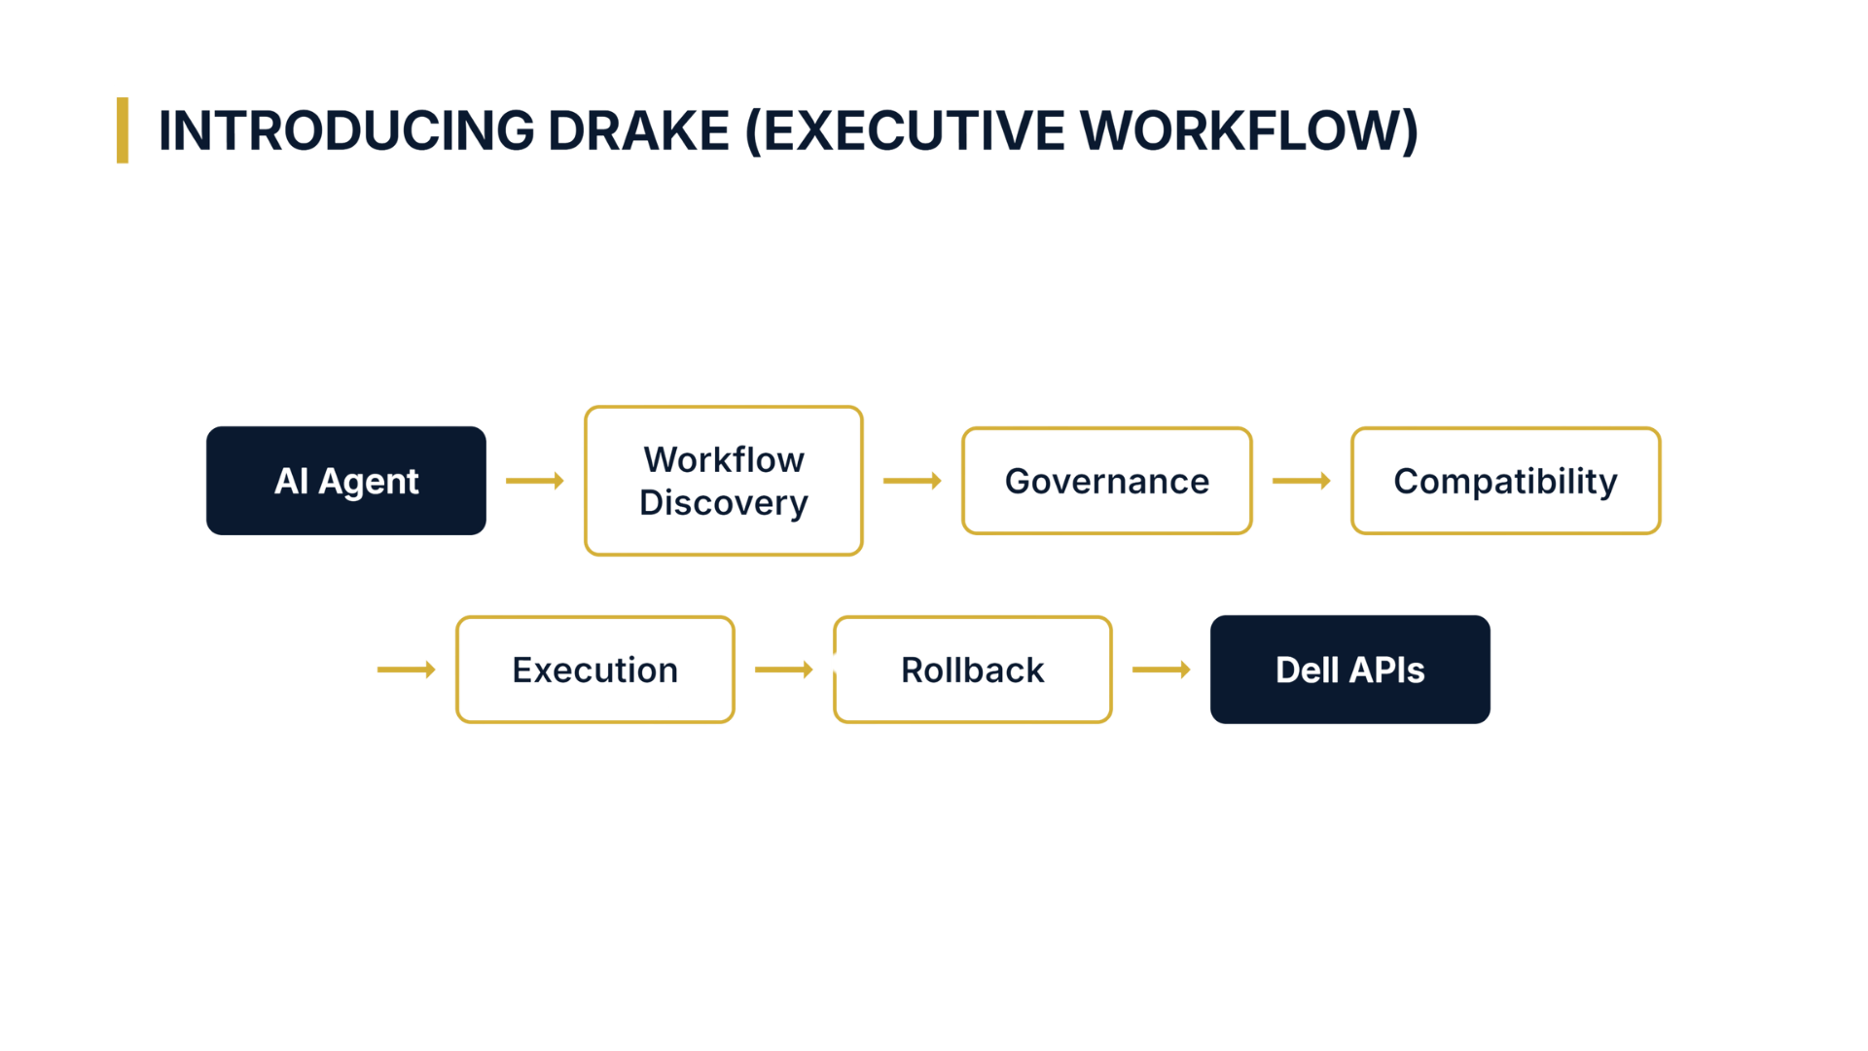

Slide 6
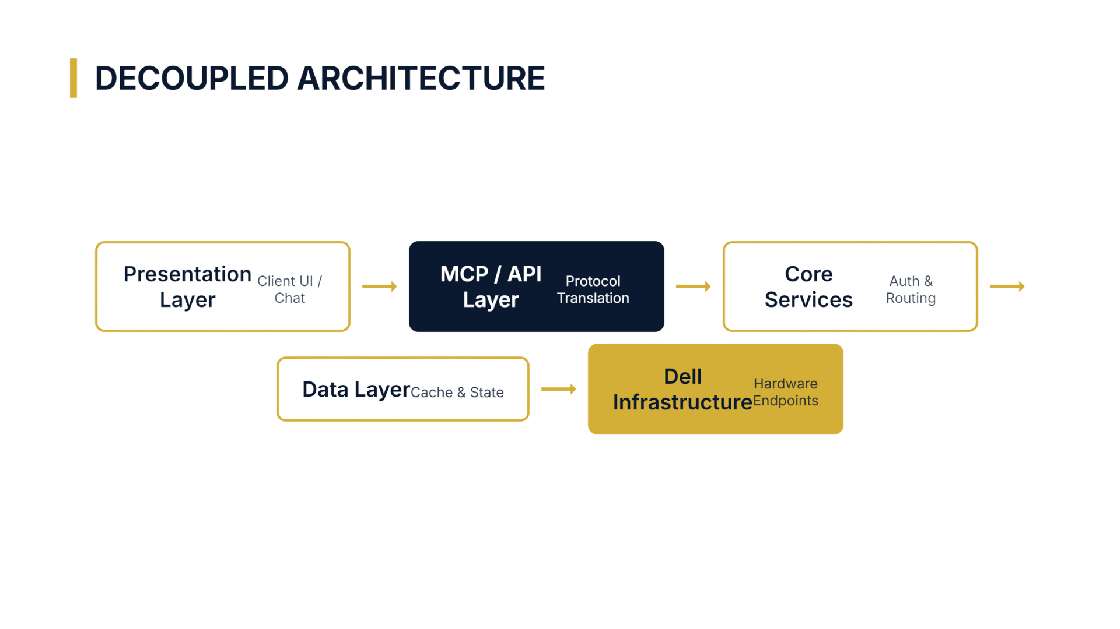

Slide 7

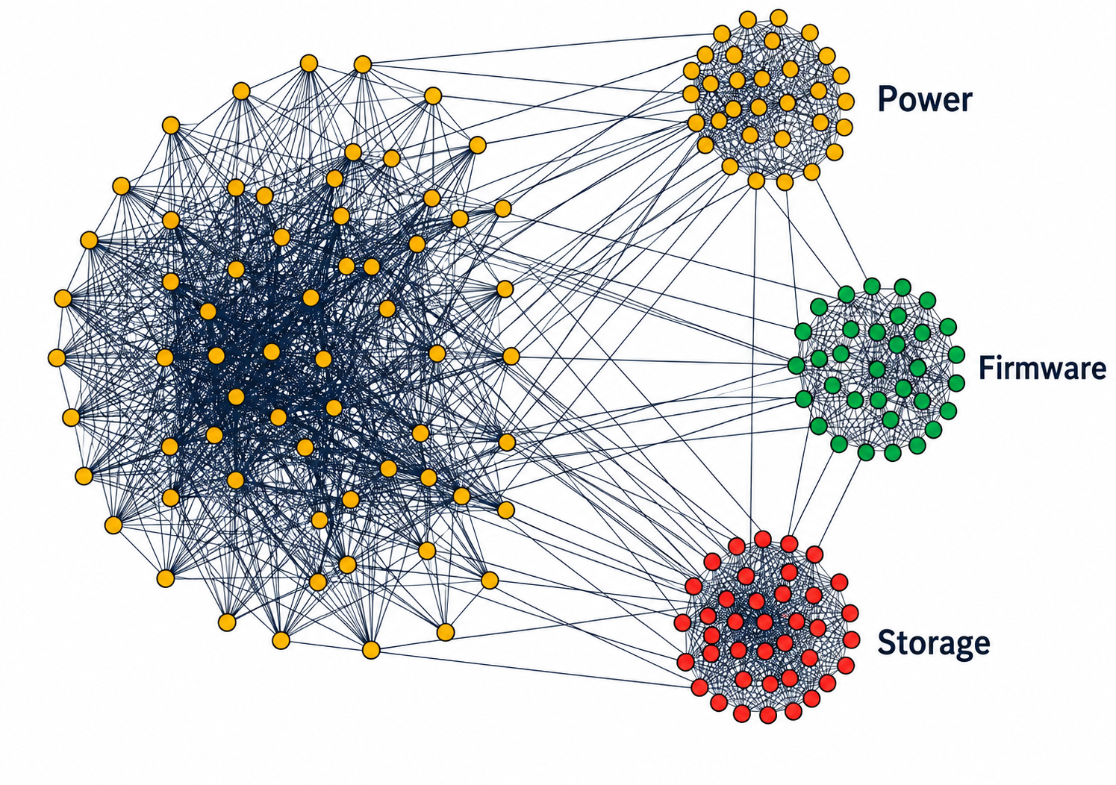
USP 1: Algorithmic Clustering Engine
Vectorization
Embeds OpenAPI endpoints using sentence-transformers for semantic similarity.
Relationship Graph
Evaluates Semantic Similarity + Tag Overlap + URL Path Hierarchy to build a weighted NetworkX graph.
Leiden Partitioning
Mathematically groups connected endpoint nodes into isolated workflow communities via Leiden modularity detection.
The result: Hundreds of low-level endpoints auto-grouped into high-level semantic workflows. No manual curation. No guesswork. Pure mathematical precision.

Slide 8
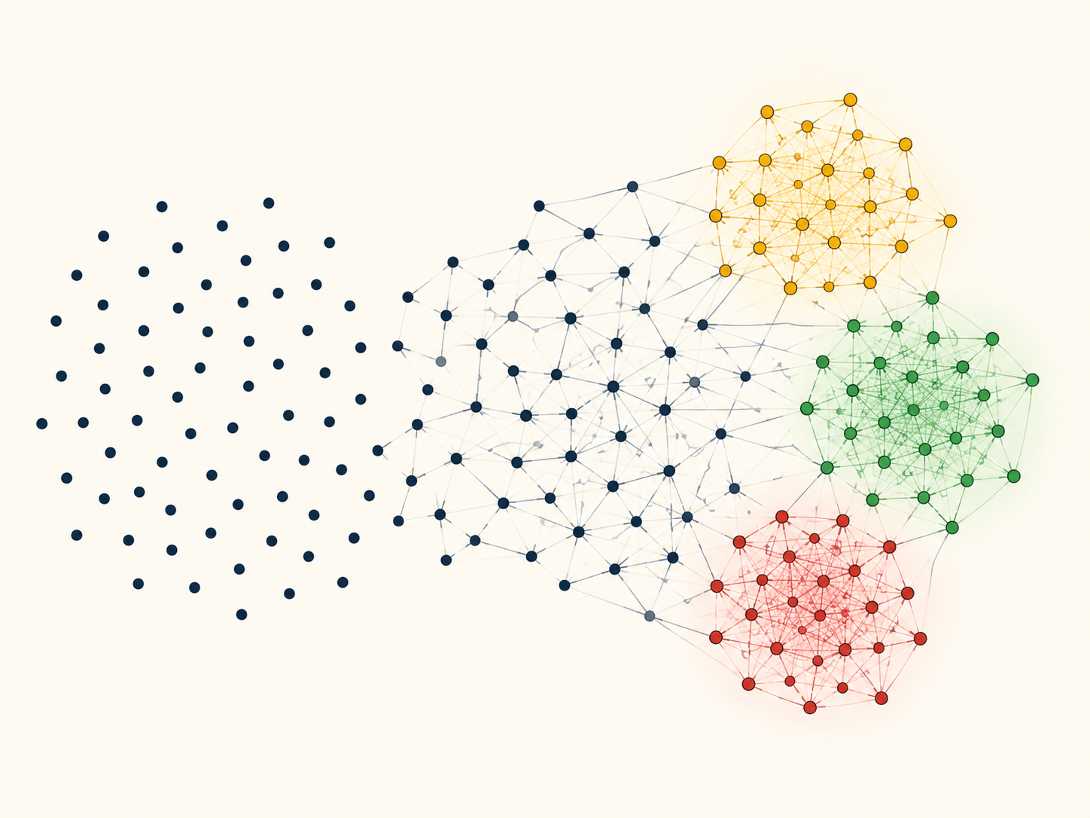

GRAPH-BASED WORKFLOW DISCOVERY
Step 1: Endpoint Similarity Scoring
$$W\left(i , j\right)=0.5S+0.3T+0.2P$$
Where:
S = Semantic Similarity
T = Tag Overlap
P = API Path Similarity
Purpose: Quantifies how closely two API endpoints are related.
Step 2: Graph Construction
$$G=\left(V , E\right)$$
Where:
V = API Endpoints
E = Weighted Relationships
Purpose: Convert 714 isolated endpoints into a connected relationship graph.
Step 3: Community Detection
$$Q=\sum{(}\left.A_{ij}−P_{ij}\right)δ\left(c_{i} , c_{j}\right)$$
Leiden Modularity Optimization
Purpose: Discover highly connected endpoint communities automatically.

Slide 9
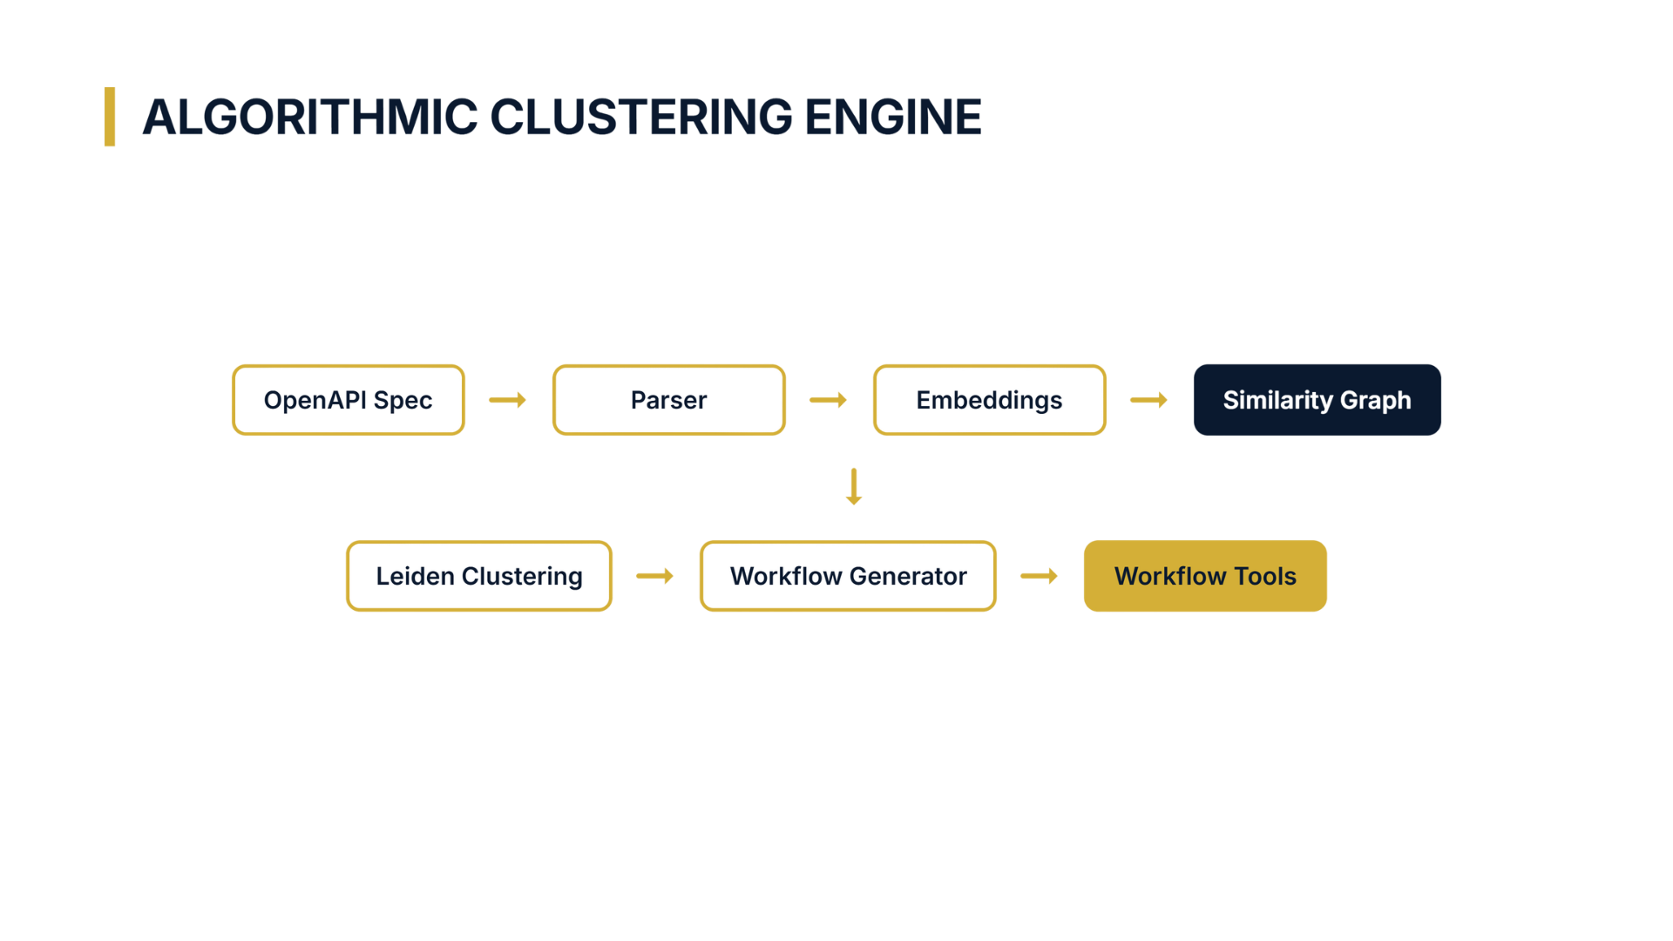

Slide 10
USP 2: Multi-API Cross-Product Orchestration
OS10 Switch
Configure VLAN/networking → Prepares network fabric for the new AI node before any compute action.
iDRAC
Mount OS ISO + Boot → Boots the node from scratch with the target OS image.
OME
Add to Compliance Baseline → Registers node with OME compliance monitoring for ongoing governance.
Provision_AI_Node Workflow → Single LLM command triggers all 3 cross-product steps in order.
Workflow
Result
One API, Three Products → Unified workflow spans OS10, iDRAC, and OME in a single Drake call.

Slide 11
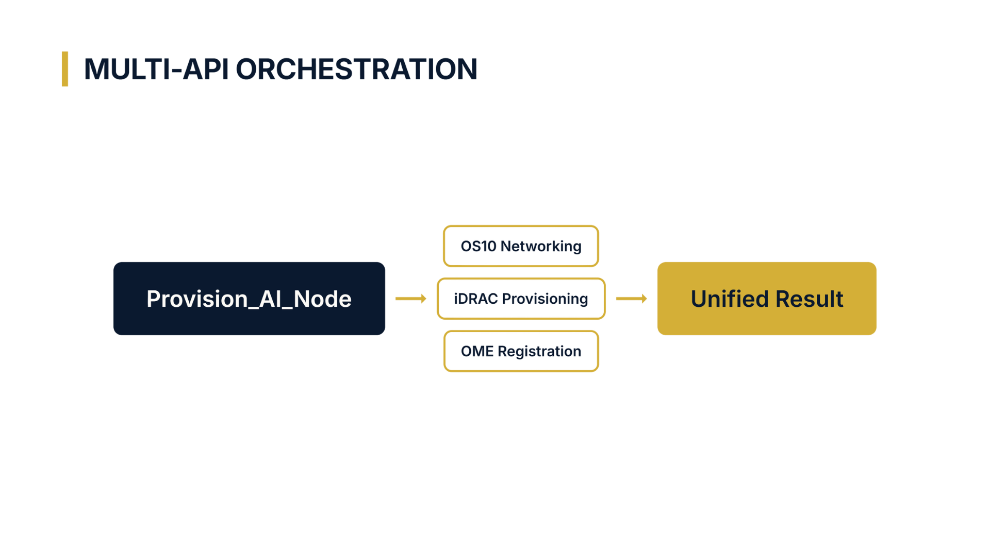

Slide 12
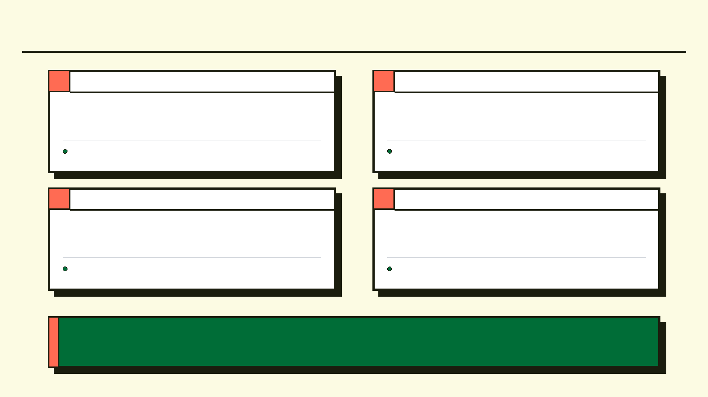
USP 3: Progressive Disclosure | USP 4: NL Workflow Compiler
1
Low Token Footprint
2
NL Pipeline Compiler
Default: Agent sees only 15 macro-workflows (~2.5k tokens, vs 120k raw).
Dramatically reduces API costs and minimizes the risk of AI hallucinations.
expand_workflow(id) dynamically injects sub-endpoints on demand.
Abstracts away complex API syntax so operators can focus entirely on business logic
3
On-Demand Expansion
4
Deterministic Output
LLM translates intent to static, repeatable API call sequences at compile time.
Keeps the baseline context clean while enabling infinite scalability
DevOps engineers describe intent in plain English to configure pipelines.
Produces safe, reviewable execution plans rather than unpredictable black-box actions
Progressive disclosure + NL compilation give operators full power without sacrificing the safety of a minimal, predictable AI footprint.

Slide 13
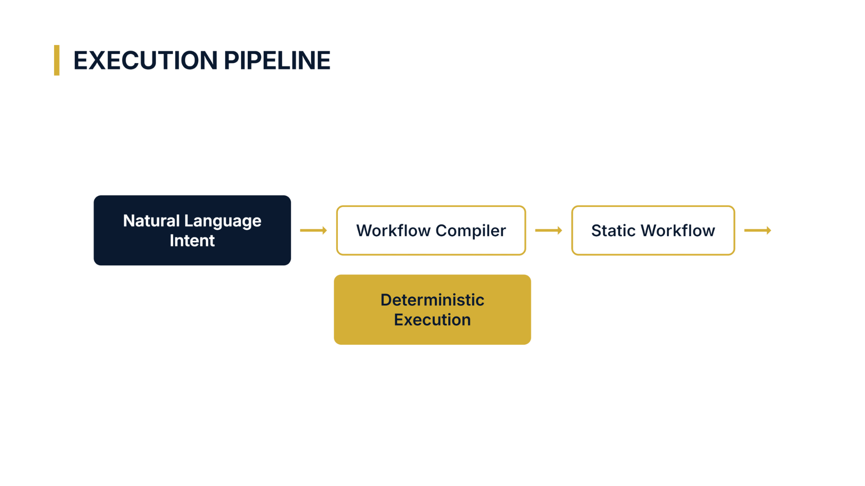

Slide 14
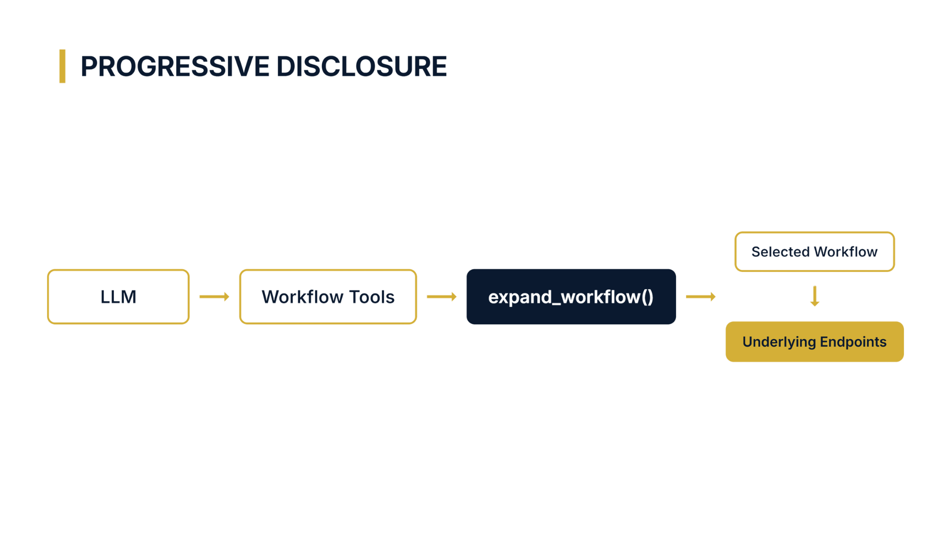

Slide 15
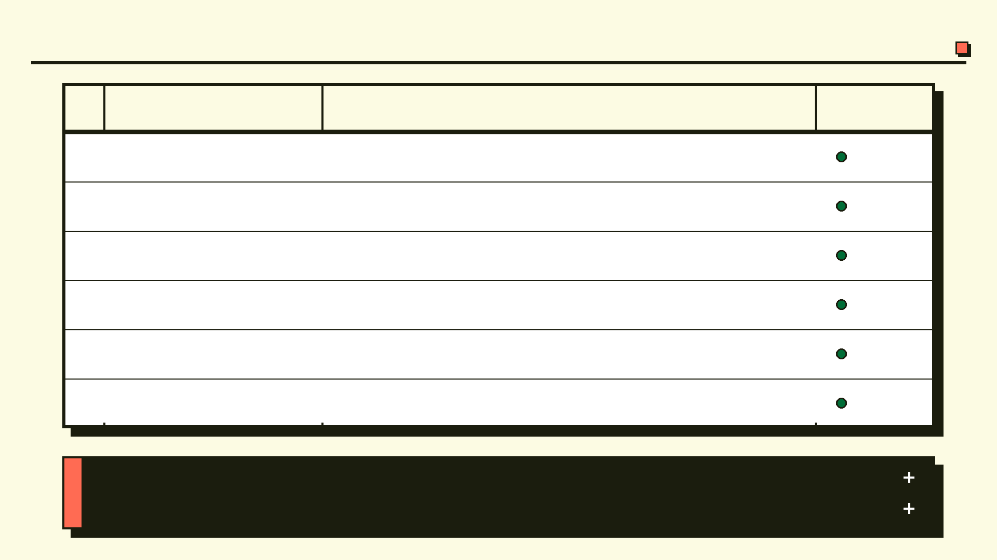
USP 5: State-Aware Rollback
#
Safety Feature
How It Works
Status
SCP XML snapshot: Full Server Configuration Profile captured before any workflow begins.
Live
1 SCP Snapshot
2
Transactional Integrity
Halt on failure: If step 3 of 4 fails, execution stops immediately — hardware remains consistent.
Live
3
Automated Recovery
Redfish rollback: Proxy triggers Redfish Dual-Bank partition swap to restore prior state.
Live
4
Pre-Execution Snapshot
Partition swap: Previous validated firmware/config bank activated so zero manual
intervention.
Live
5
Redfish Dual-Bank
OTel trace: Every AI action is traced end-to-end: from LLM intent to exact raw HTTP payload executed on iDRAC.
Live
6
OpenTelemetry Logging
Human-in-the-Loop checkpoint: preview all workflow steps before any hardware command executes.
Live
Pre-execution snapshots, transactional halts, and Redfish rollback run before every hardware operation. Zero exceptions. Zero overrides. Every action logged immutably.

Slide 16
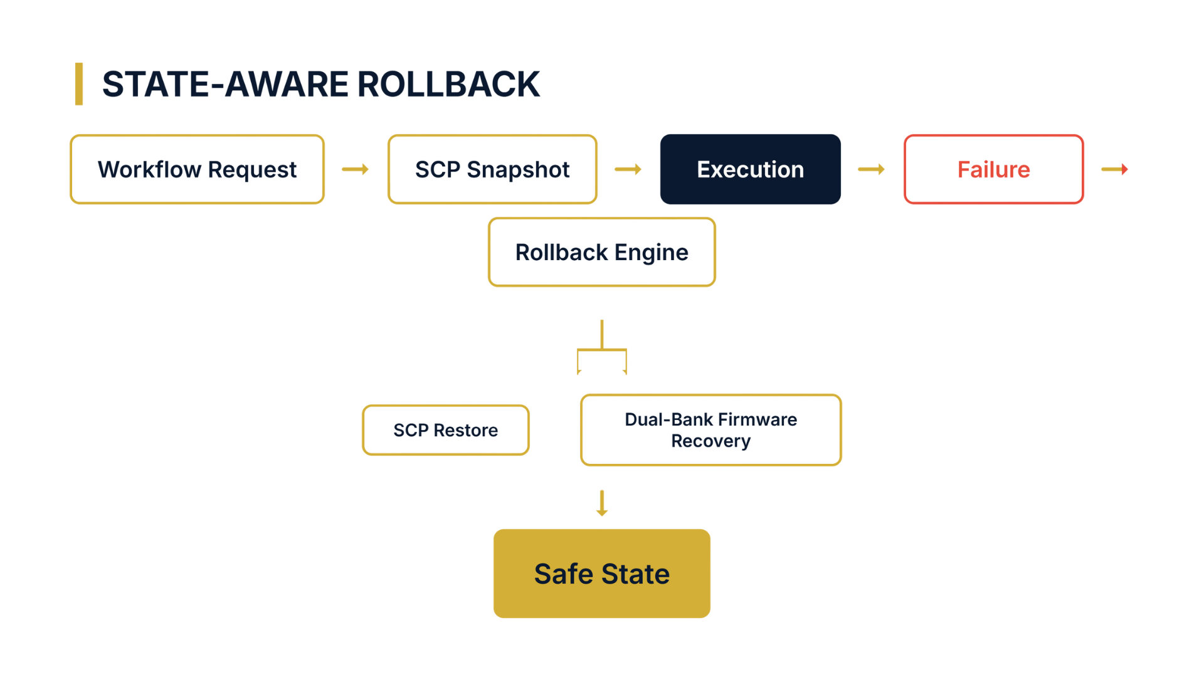

Slide 17
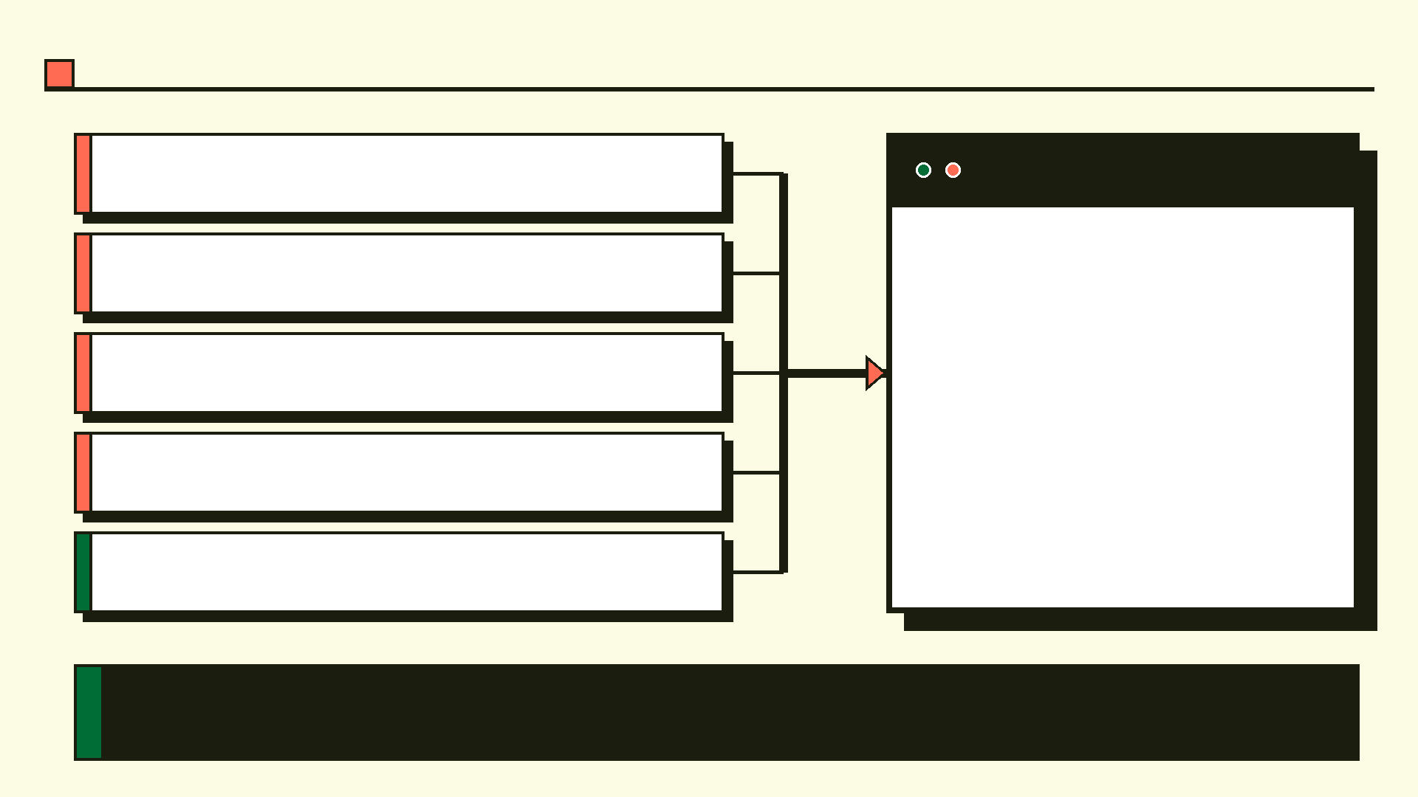
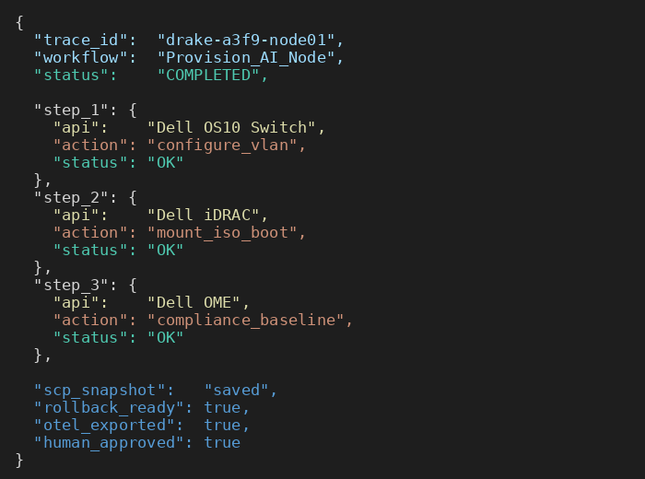
USP 6: The Governance & Observability Cockpit
OTel Emission: Every AI action is traced and logged via OpenTelemetry. Full audit trail from LLM intent to raw HTTP payload.
Human-in-the-Loop: Preview workflow steps before execution. Operators can inspect and approve before bare-metal command runs.
Auditability: Maps the LLM high-level intent to exact raw HTTP payloads executed on iDRAC. Zero black-box actions.
Compliance-Ready: Security teams get full visibility. Every decision logged with reason codes to an immutable audit trail.
Risk Assessor: Pre-execution Fast Pre-Filter scores risk and blocks dangerous operations before they reach hardware.
Security teams will not allow AI in the datacenter without full visibility. Drake gives them that—complete observability, zero black-box actions, and a human checkpoint at every critical step.

Slide 18
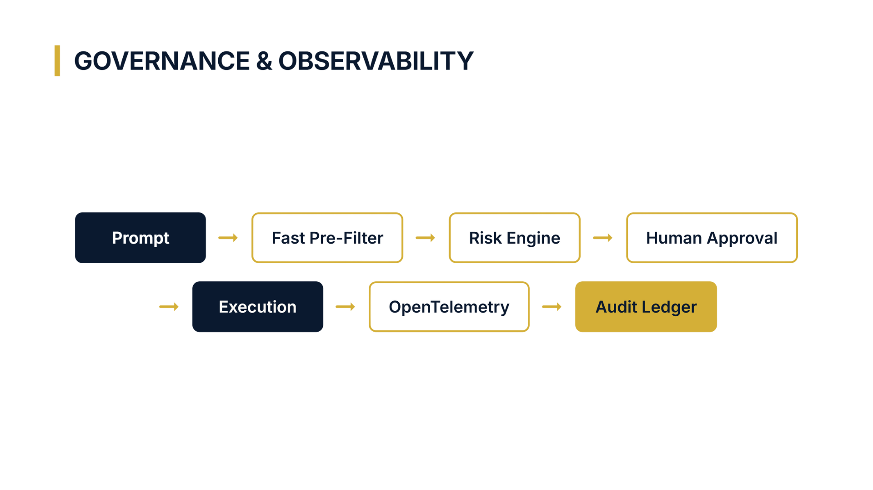

Slide 19
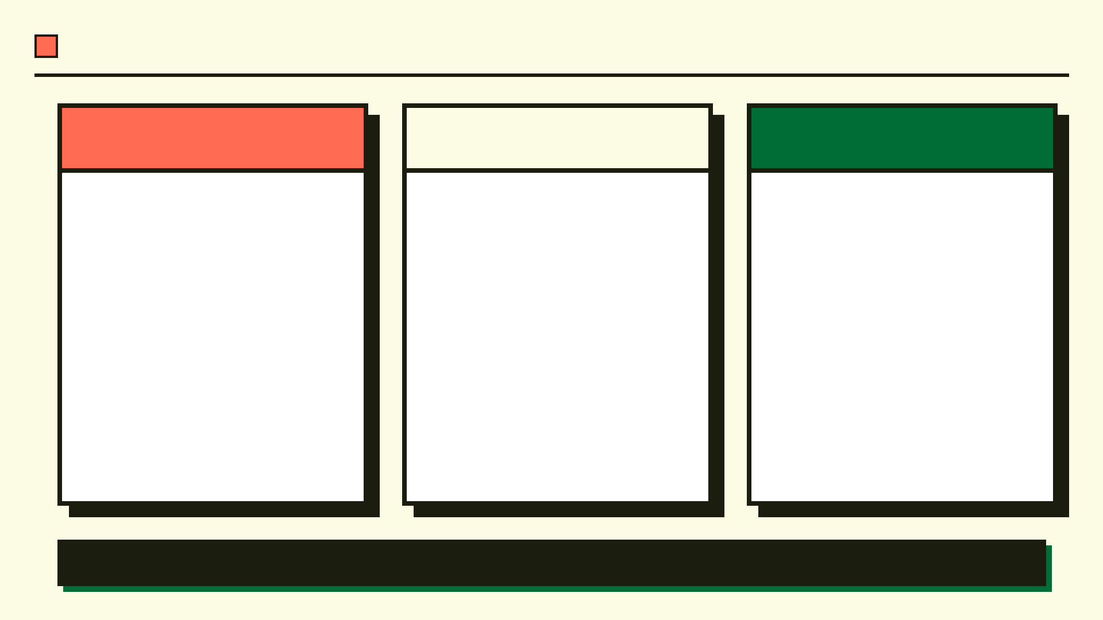
Proving the Impact: Token Math & ROI
Raw iDRAC Spec
Drake Proxy
Results
120 Workflows
→ ~2,500 tokens
Static routing
Zero subjectivity
>95% Token Reduction
Zero Hallucinations
Millisecond Latency
100% Safe Rollback
700+ endpoints
→ ~120,000 tokens
LLM tool paralysis
Hallucinated params
“ 720 raw endpoints slashed to 120 semantic workflows. Context window cost reduced by over 95%. ”

Slide 20
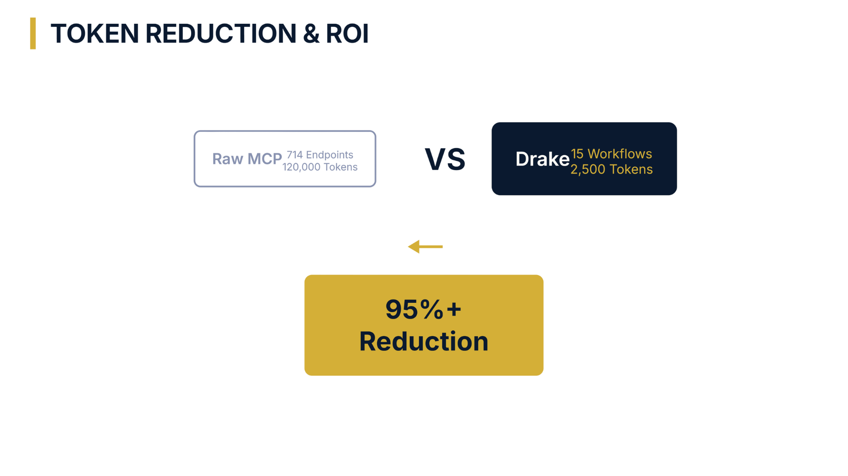

Slide 21
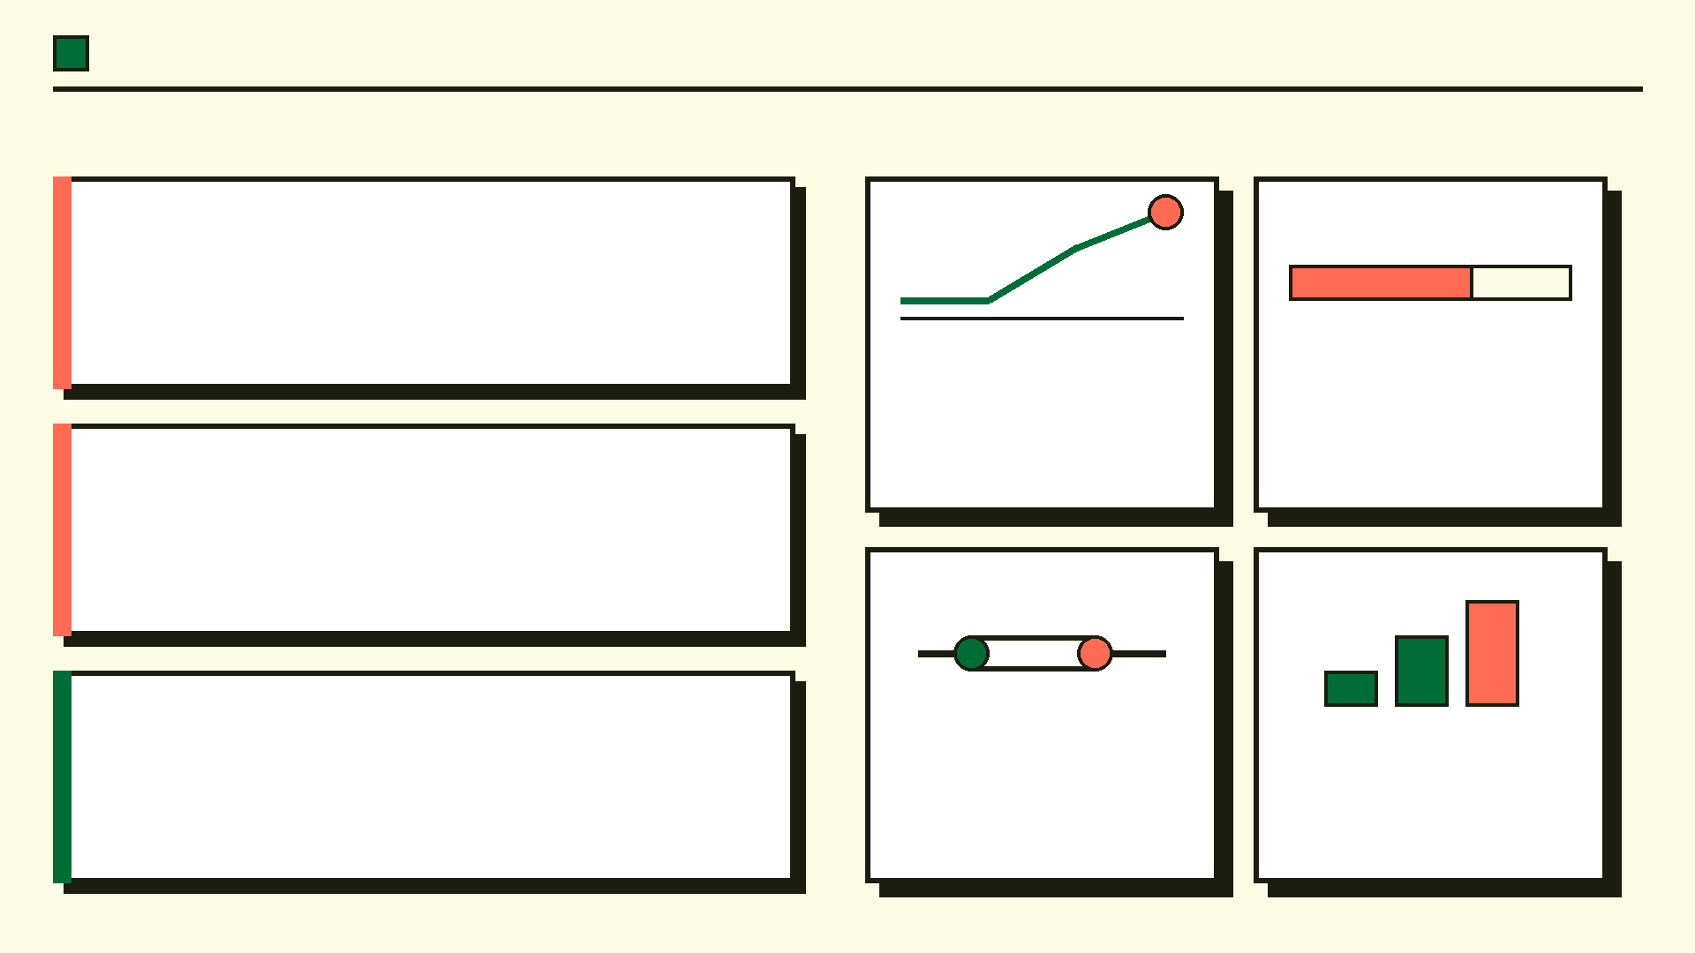
The Future of Agentic Datacenters
Completed:
Solved the 1:1 API mapping bottleneck across 714 Dell iDRAC endpoints. Enabled transactionally safe, multi-API AI infrastructure management with full observability.
Zero-Trust Auth
Leiden Engine
Pluggable auth modules: OIDC, SAML, mTLS — enterprise SSO without core proxy changes.
The clustering pipeline will be open-sourced so any enterprise can auto-group their own API specs.
Roadmap: Pluggable Zero-Trust Authentication. Open-source the Leiden clustering engine. Dynamic payload caching. Multi-cloud expansion to Azure Arc and AWS SSM.
Payload Cache
Core Pillars: Algorithmic Abstraction | Pre-Flight Verification | State-Aware Rollback. Enterprise-grade governance for every AI action on bare-metal infrastructure.
Multi-Cloud
Intelligent response caching reduces redundant iDRAC calls and cuts API latency further.
Extend Drake to support Cloud and hybrid datacenter management alongside Dell APIs.

Slide 22

THANK YOU!

